Slide 1
LAWS 8421 Income tax
Topic 12 Anti-avoidance

Slide 2
Specific v general anti-avoidance measures
Specific anti-avoidance, eg —
Trust stripping rules, s 100A ITAA 36
Anti-dividend streaming rules, s 45A ITAA 1936
Non-commercial loss rules, Division 35 ITAA 1997
Promoter penalty rules, Div 290, Sch 1, Tax Administration Act
General anti-avoidance
Part IVA, ITAA 1936

Slide 3

Spectrum of behaviours
Tax Planning
Tax Avoidance
Tax Evasion
Legitimate
Dishonest
Unethical / contrary to policy

Slide 4
Tax Evasion
Involves dishonesty
Illegal

Slide 5
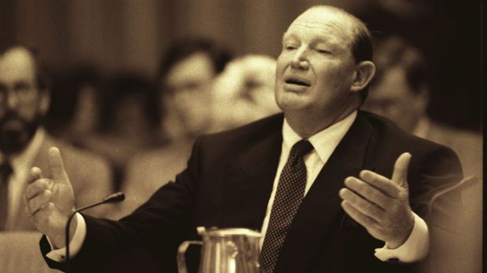
Legitimate tax planning
This material has been reproduced and communicated on behalf of ANU pursuant to Part IVA Division 4 of the Copyright Act 1968 (Cth)
Photo: Peter Morris

Slide 6
Legitimate tax planning (ctd)
"I don't know anybody that doesn't minimise their tax …. I'm not evading tax in any way shape or form. Of course I'm minimising my tax. If anybody in this country doesn't minimise their tax they want their head read. As a government I can tell you you're not spending it that well that we should be paying extra." [Source, Kerry Packer, 1991, SMH]

Slide 7
Legitimate tax planning (ctd)
Per Chief Justice Gleeson and Justice McHugh in Commissioner of Taxation v Hart (2004) -
… the fact that a particular commercial transaction is chosen from a number of possible alternative courses of action because of tax benefits associated with its adoption does not of itself mean that there must be [a purpose of avoiding tax]. Taxation is part of the cost of doing business and business transactions are normally influenced by cost considerations.

Slide 8
Legitimate tax planning (ctd)
Asprey Committee (1975) –
An act within the law [11.1]
By the use of documents and the adoption of procedures to which the Courts are impelled to give an operation according to their legal effect, it has become a not too difficult matter for some who have access to highly skilled advice to avoid a situation which the statute intended should be either taxable or taxable upon a higher scale. [22.7]

Slide 9
Part IVA
Introduced in 1981 by John Howard to replace section 260 of the 1936 Act.
Justice Callinan, in Hart, described Part IVA in this way:
… the direction in Part IVA to consider the ‘form and substance’ of a scheme ‘is whether the substance of the transaction (tax implications apart) could more conveniently, or commercially, or frugally have been achieved by a different transaction or form of transaction.

Slide 10
Sections 177F & 177D
The Commissioner may cancel a ‘tax benefit’ obtained by a taxpayer ‘in connection with a scheme’ if one or more of the persons who participated in the scheme (or part of the scheme) did so for the ‘sole or dominant purpose’, objectively ascertained, of enabling the taxpayer to obtain a tax benefit in connection with the scheme

Slide 11
Scheme, s 177A
A ‘scheme’ is defined broadly to mean ‘any agreement, arrangement, understanding promise or undertaking’ and ‘any scheme, plan, proposal, action, course of action, or course of conduct.

Slide 12
Tax benefits, ss 177C
An amount not being included in assessable income
A deduction being allowable
A capital loss being incurred
A foreign income tax offset being allowable
An innovation tax offset being allowable
An exploration credit being issued
An amount of withholding tax not being incurred
A loss carry back offset being allowable
An R&D offset being allowable

Slide 13
Objective purpose, s 177D
Section 177D , the purpose of those who entered into the scheme must be ascertained objectively based on an analysis of —
The manner in which the scheme was implemented
The form and substance of the scheme;
The time at or over which the scheme was carried out;
Any change in the financial position of the taxpayer as a result of the scheme;
Any change in the financial position of any other person connected to the taxpayer, as a result of the scheme;
Any other consequence for the taxpayer or those connected to it; and
The nature of the connection between the taxpayer and those connected to it.

Slide 14
Three inter-related integers
Scheme
Purpose
Tax Benefit
Understood and unified by the ‘alternative postulate’

Slide 15
Compare actual with alternative
Actual
Scheme
Substance and effect
Alternative Postulate
Purpose
Tax Benefit
Was AS artificial, convoluted, contrived
compared to AP?
Does tax on AP > tax on AS?

Slide 16

Bank Deposit Example
Exempt
Income
Cook Island Bank
$i - margin
$i
Oz Bank Sydney
Actual
Scheme
Taxpayer
$p + fees
+ w/tax
$p + fees
Extra
costs
Assessable
Income
$i
Oz Bank Sydney
Alternative
Postulate
Taxpayer
$p + fees

Slide 17
Alternative postulate
Another way the taxpayer could have achieved the same non-tax outcomes —
Annihilation postulate – s177CB(2)
Reconstruction postulate – s177CB(3)&(4)

Slide 18
Administration
2013 Remedial Amendments, RCI, Axa, Lenzo
PSLA 2005/24DC – Application of Anti-Avoidance Rules
Tax Counsel Network / Deputy Chief Tax Counsel
GAAR Panel

